Slide 1
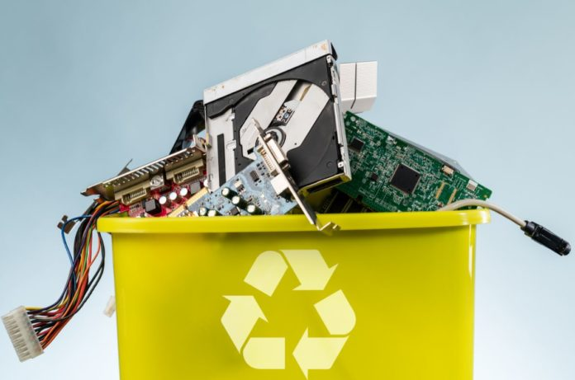
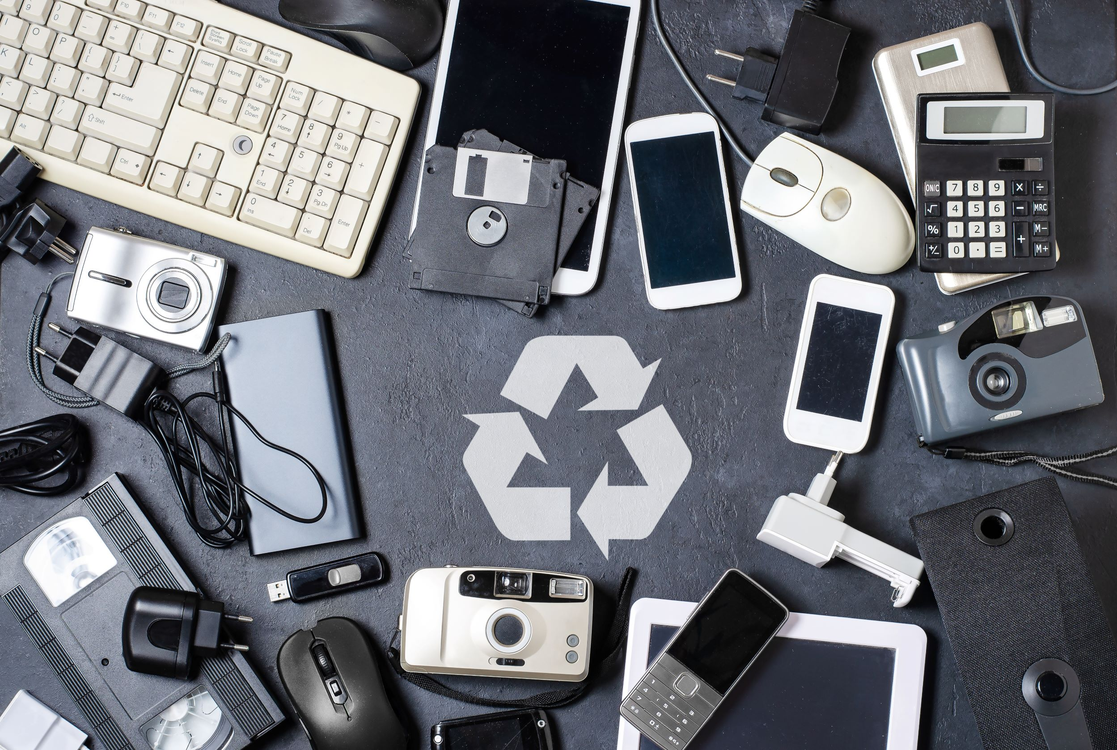
EXTENDED PRODUCER RESPONSIBILTY AND ITS ROLE ON WEEE MANAGEMENT. DOES IT MATTER? A CASE OF KENYA, EAST AFRICA
This Photo by Unknown author is licensed under CC BY.
Sarah Njau

Slide 2
What is EPR
A policy approach that places the responsibility for the disposal and management of end-of-life products on the producers.
The objective of EPR is to encourage producers to design products that are easier to recycle and dispose of, and to reduce the environmental impact of products at the end of their life cycle.

Slide 3
Kenya’s proposed EPR Categories
Packaging for non-hazardous products (plastics, papers, aluminium, composite, glass and carton).
Hazardous products’ packaging (Industrial chemicals, oil and lubricants, pharmaceuticals, agrochemicals, veterinary, paints and solvents) and agricultural films
Electrical, Electronic Equipment, Mercury Auto Switches, thermostats, Battery and Accumulators
End of life motor vehicles, automobiles, aircrafts, locomotives
Non packaging items (Plastics, glass, paper, cardboard), Furniture (except wooden, metallic), Rubber and Tyre

Slide 4
Why it matters
The introduction of EPR would lead to an increase in the collection and recycling of WEEE, which reduces the amount of hazardous waste sent to landfills
Producers would also start designing products that are easier to recycle, which reduces the cost and complexity of managing WEEE.
Create employment opportunities in the waste management sector, particularly in the collection and recycling of WEEE.

Slide 5
Encouraging eco-design in electrical appliances that are cost-effective and minimize pollution.
Encouraging responsible use of electronics.
Encouraging reuse and refurbishment of electronic products
Encouraging the use of non-toxic materials and manufacturing processes

Slide 6
Improving resource efficiency in material inputs and energy consumption
Reducing pollution from production and waste treatment
Creation of new profitable business opportunities and a recycling industry niche.
A move towards circular economy that promotes sustainable production and consumption.

Slide 7
Challenges of EPR Implementation
Lack of awareness among consumers about the importance of responsible waste management.
Lack of infrastructure and capacity for waste management in many parts of the country.
Lack of enforcement mechanisms to ensure that producers comply with the EPR regulations.

Slide 8
Conclusion
EPR has the potential to play an important role in improving WEEE management in Kenya and other countries in East Africa. However, the success of EPR policies will depend on a range of factors, including regulatory enforcement, stakeholder engagement, and the availability of appropriate recycling infrastructure.

Slide 9
THANK YOU

